Slide 1



www.illinoisworknet.com
http://ilcis.intocareers.org
Practical Guide to Illinois’ Career Information and workNet® Systems and
How to Help People Achieve Career, Training, and Employment Goals

Slide 2



Goal:
Connect all citizens to resources for achieving career, training, and employment goals.

Slide 3


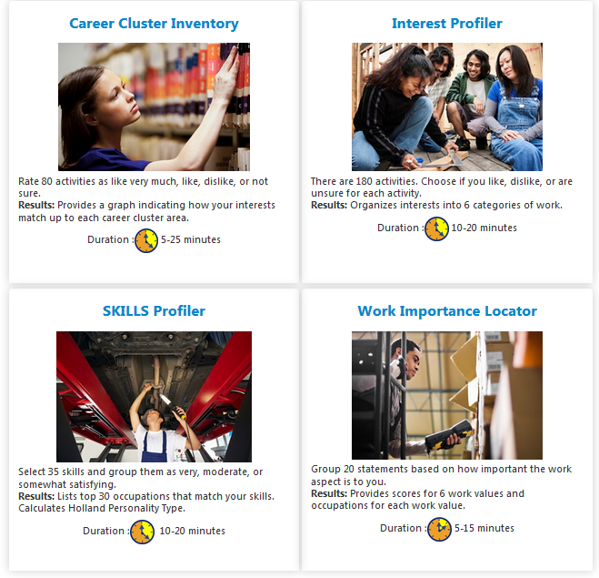

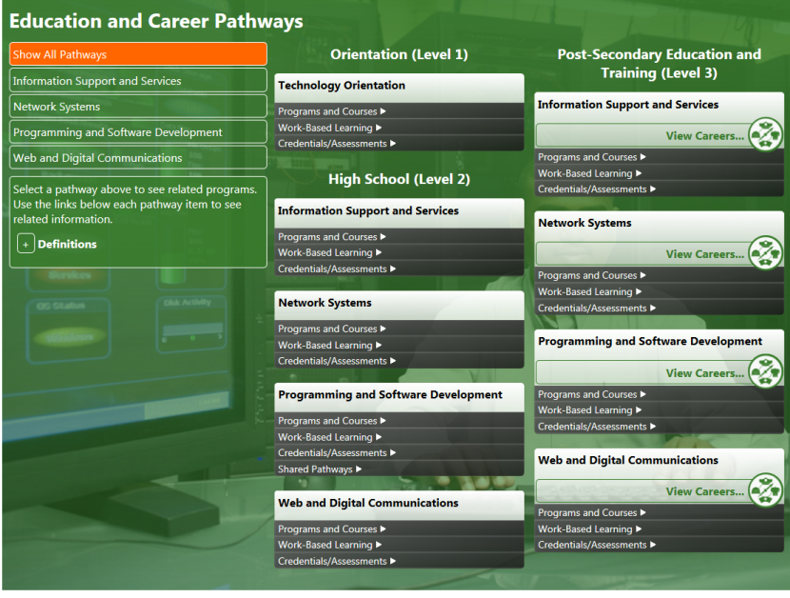
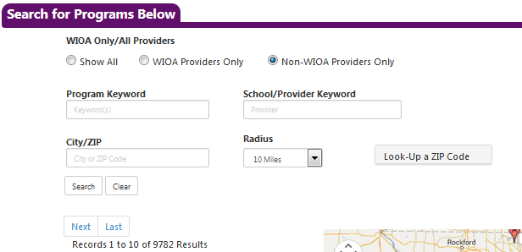

CIS – Career Info for All Ages
2.
1.
You can find the same, cohesive information any way you access CIS tools, which include:
Skill & Interest Surveys
  Interest Profiler
  SKILLS Profiler
  Work Importance Locator
  Career Cluster Inventory
Career Exploration
Illinois Training Program Search
Illinois Pathways – Careers & LMI Data
4.
3.

Slide 4

Illinois Career Information System (CIS)
For direct access to the Illinois Career Information System visit http://ilcis.intocareers.org.
You can also call 877-566-6230 or email for assistance: des.cis@illinois.gov/.

Slide 5
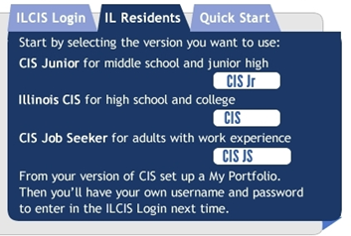
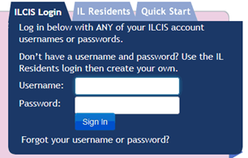
Illinois Career Information System (CIS)
You have many options to choose from when you go to the CIS website.

Slide 6
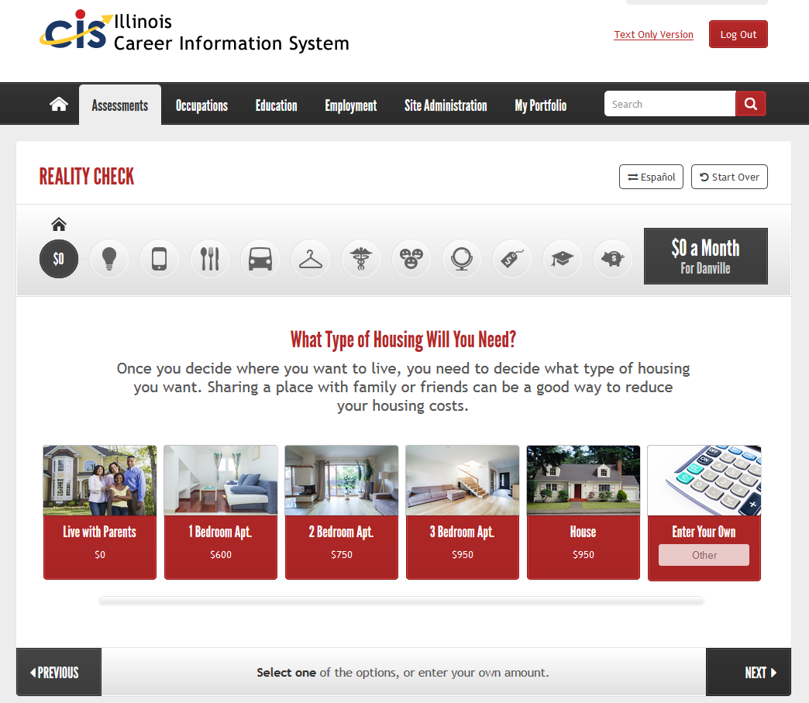
CIS – Reality Check
The Reality Check tool walks you through what it’s like being an adult with bills like housing, food, clothing, transportation, and other items.
This tool is great to use to find out your cost of living needs before searching for training or a job.

Slide 7



Illinois workNet® Web Portal System and jobPrep App
Illinois workNet® is a portal to connect individuals, employers, and education, workforce and community partners to career planning, education and training, and employment resources and tools. The portal connects people to local and statewide in-person and online services.
Web Portal – http://www2.illinoisworknet.com
jobPrep Mobile App includes capabilities that assist job seekers with their employment needs, all from the convenience of a smartphone. The free app is available for downloading from iTunes, Google Play and Amazon.
jobPrep Mobile App – http://www.illinoisworknet.com/jobprep

Slide 8
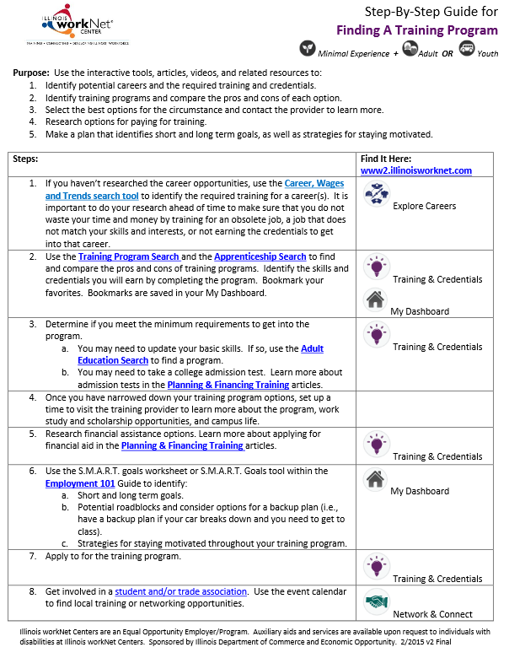
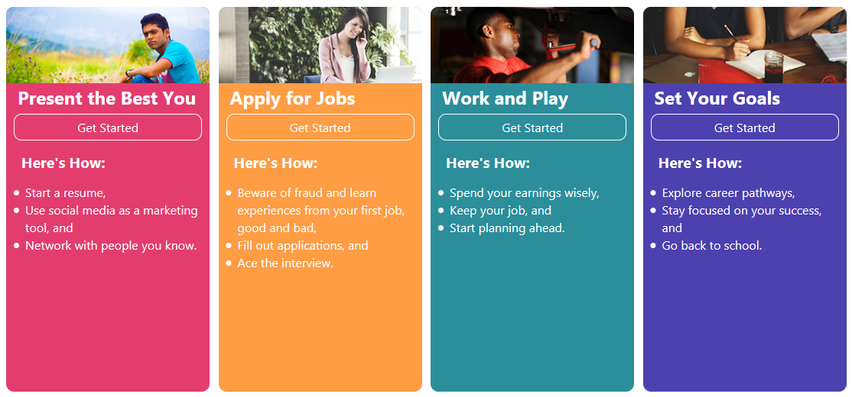
User Guides
Mostly one or two page printable PDF documents that provide steps or instructions for getting started. There are some web page guides too.

Slide 9

Where to
Find User Guides
From the home page, use the arrows on the left and right and click on the scenario that best fits your needs.

Slide 10
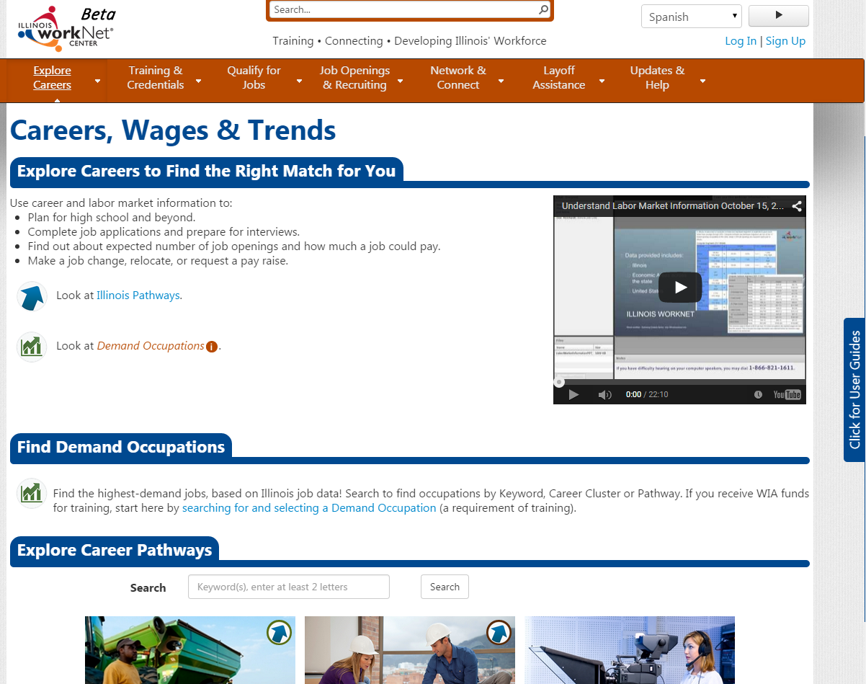
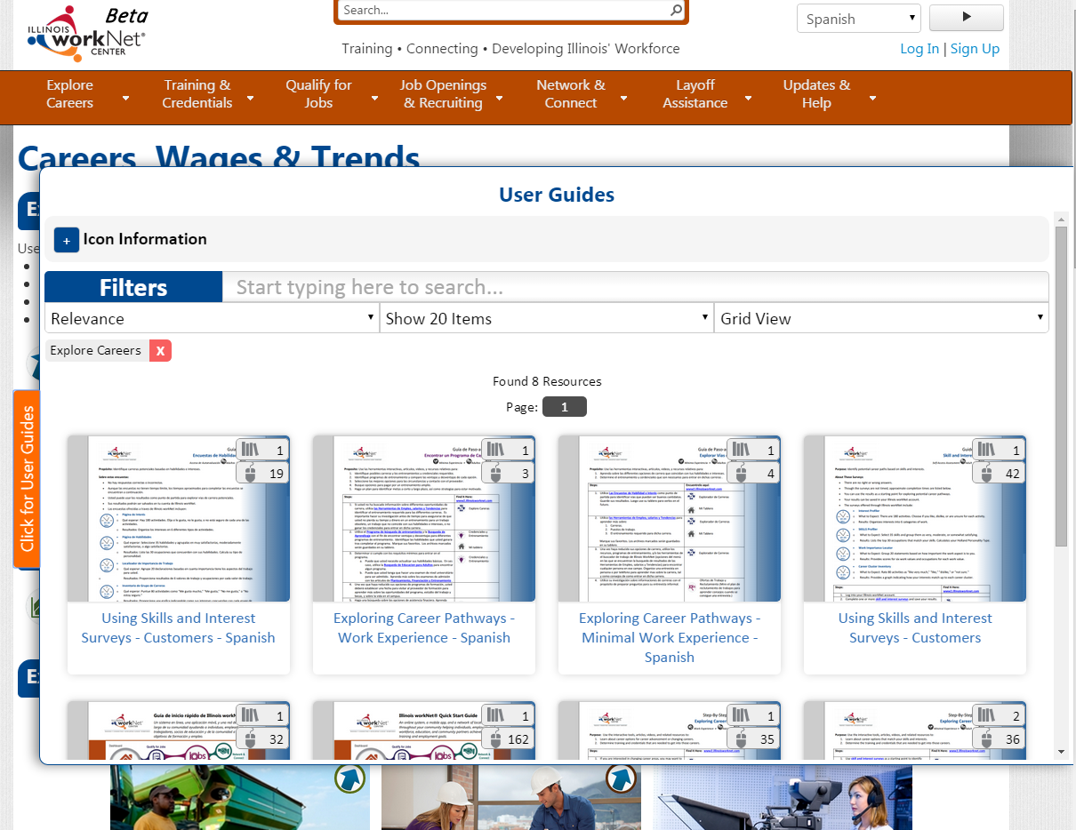
Where to Find User Guides
Click the tab on the right side of each page and it will show you guides related to the area of the site you’re in. Click it again to close it.

Slide 11


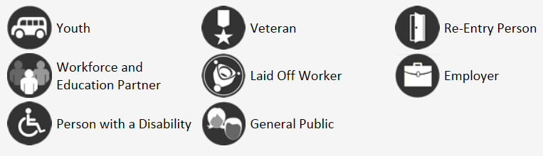

How to Use the Guides
Go to https://www2.illinoisworknet.com/ and select User Guide Scenarios right from the home page.
Use the icons to determine the most helpful guides.
Minimal Experience
Work Experience

Slide 12
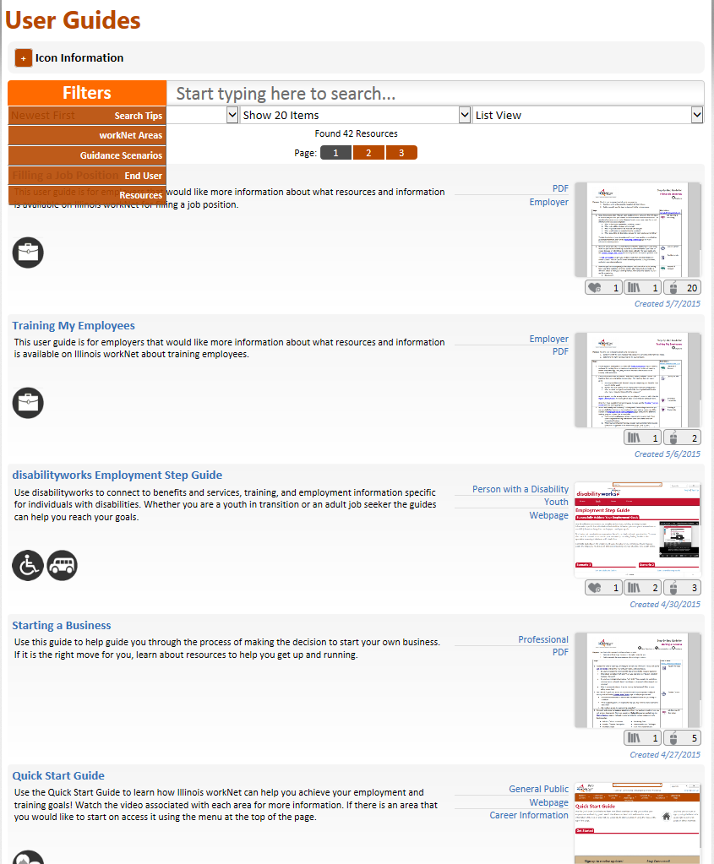
How to Use the Guides
Click on any guide.
Download and/or save and/or print PDFs.
Click the Icon Information to find out what the icons mean.
Optionally, use the filters and search to find guides.
Show between 20 or more guides at a time.
View the guides as shown to the right, or select the grid view, or text only view.

Slide 13



Example Scenarios
I want to explore career options.
I need to find training options
near me.
I am a young adult looking for a summer job.

Slide 14
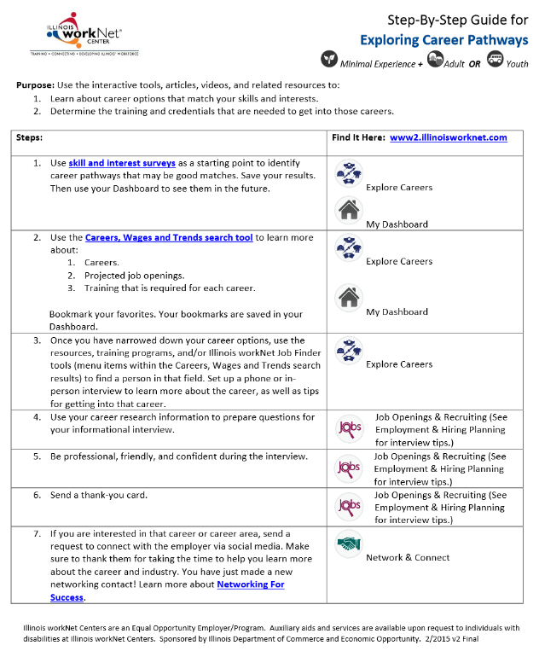
3-Step Strategy Example:
I don’t know what kind of careers are out there.
Select the guide that best fits your scenario.
Print the guide and use it as a checklist to keep track of what you’ve done along the way. Illinois workNet and the CIS tools identified in the guide will help you explore your skills and careers that may be a good match for you. Complete Skills & Interest Surveys Explore Careers, Wages, and Trends Search for Training Programs
If you don’t have a home computer, you can visit your local Illinois workNet Center for access.
Minimal Experience
Work Experience

Slide 15
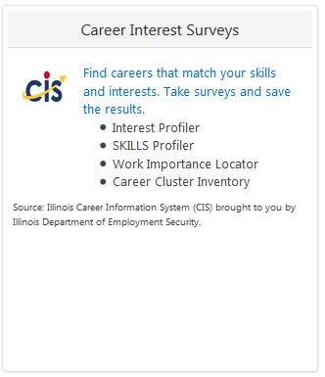
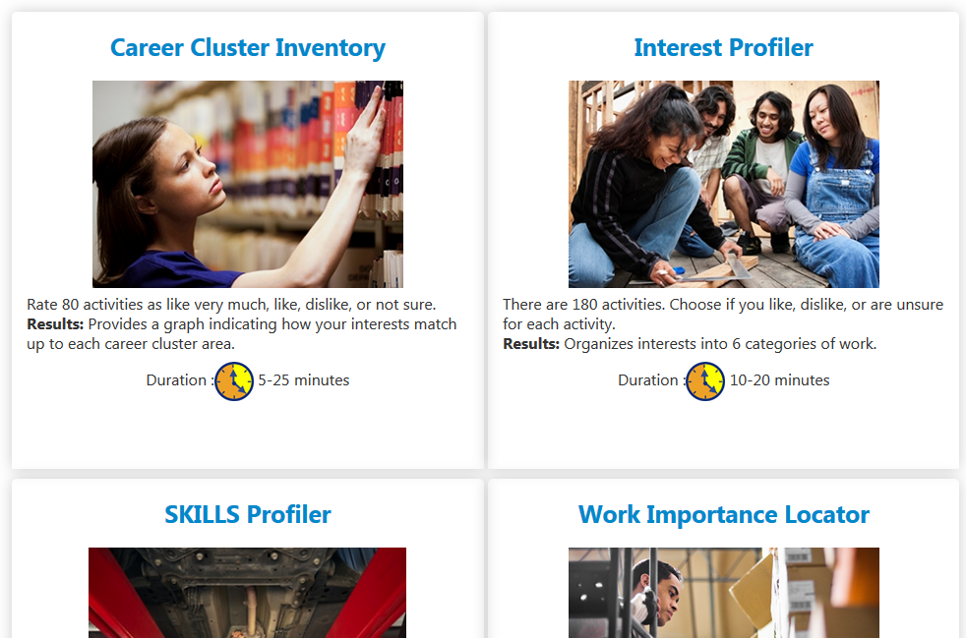
Skills & Interests Survey
Explore survey options and why you should use them.
From your My Dashboard, select CIS.
Complete any/all the surveys you would like to take.
Use your results to learn about jobs you may be interested in, a new career field, and more.

Slide 16
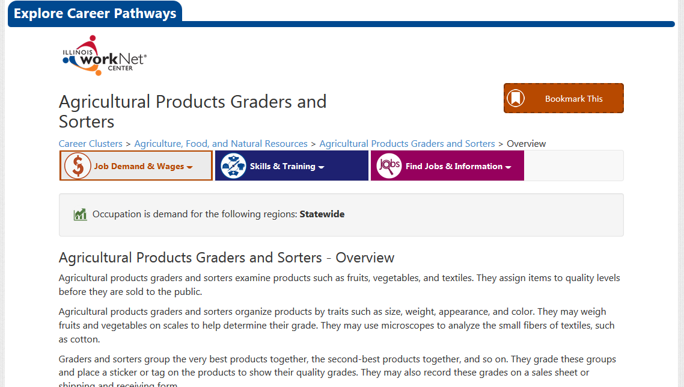
Careers, Wages, & Trends
Select a Career Pathway
  Icons indicate Illinois Pathways
Select a Career Cluster
  Icons indicate Demand Occupations
Review:
  Overview
  Employment & Outlook
  Wages & Trends
  Resources
  Interests, Knowledge, Licensing/Certification,
  Skills & Abilities
  Training Programs
  Advancement Opportunities
  Hiring Practices
  Search for Jobs
  Physical Demands
  Similar Jobs
  Working Conditions

Slide 17
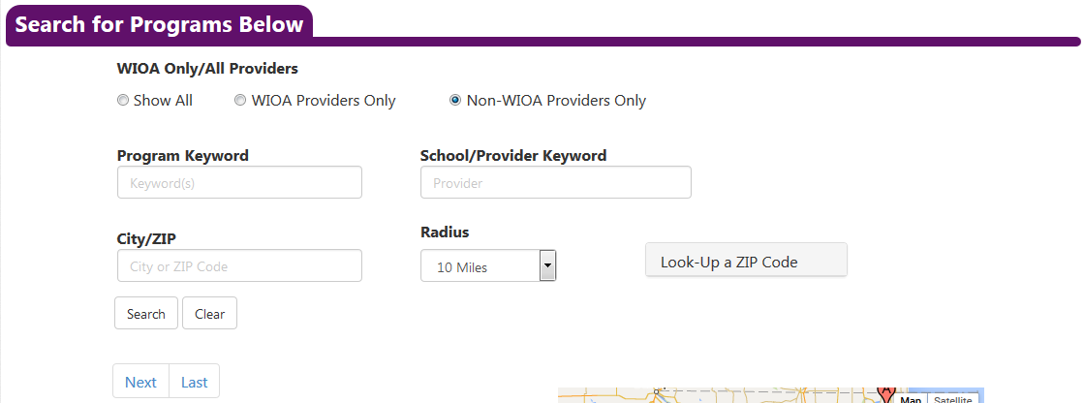
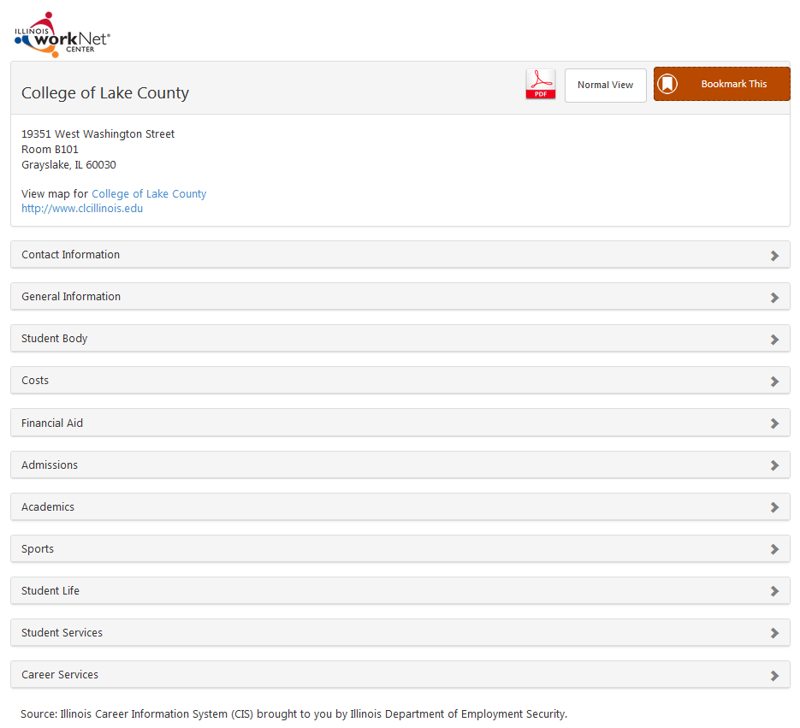
Training Program Search
Search by Program Keyword, School/Provider and/or City/ZIP. OR
Blind search to pull all programs.
Select a Program to review:
  Contact Information
  General Program Information
  Student Body
  Costs
  Financial Aid
  Admissions
  Academics
  Sports
  Student Life
  Student Services
  Career Services

Slide 18
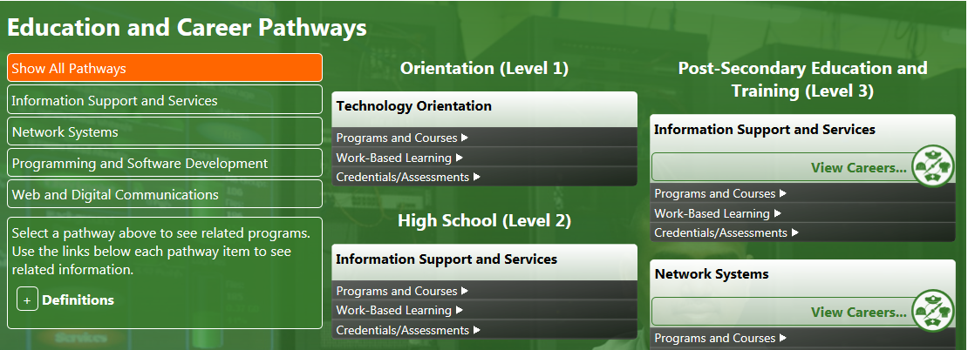
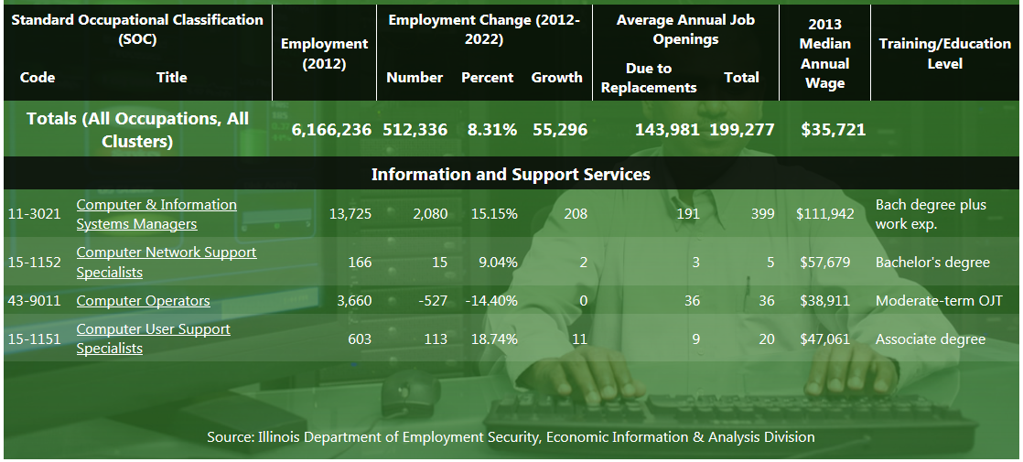
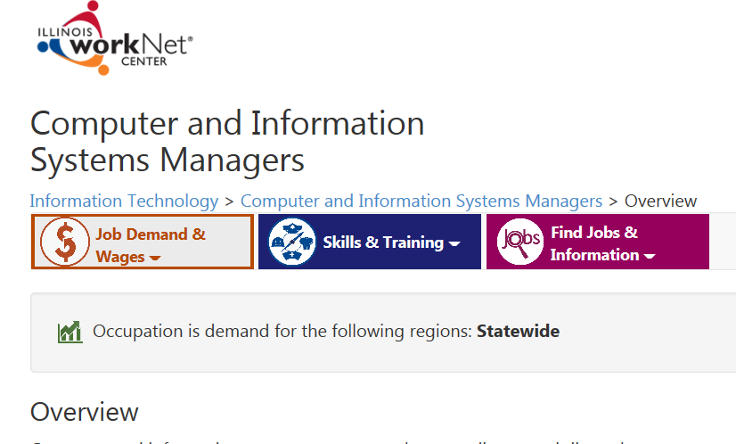

Illinois Pathways
Select one of the 9 Illinois STEM Career Clusters.
  Agriculture, Food, & Natural Resources
  Architecture & Construction
  Energy
  Finance
  Health Science
  Information Technology
  Manufacturing
  Research & Development
  Transportation and Logistics
Select a Pathway.
Select “View Careers” for LMI Data and Career Information.
www.ilpathways.com

Slide 19

Questions?

Slide 20
Thank You - Contact Us
Illinois workNet
Visit: www.illinoisworknet.com
Email: info@illinoisworknet.com
Monday – Fridays
8:00 am – 4:30 PM
Emails are checked and responded to each business day.
Illinois Career Information System
Visit: http://ilcis.intocareers.org
Email: des.cis@illinois.gov
Call: 877-566-6230
Monday – Fridays
8:00 am – 5:30 PM
Emails are checked and responded to each business day, calls are returned within 24 hours.

